Slide 1

Saturday Special: Data Visualization
Data Science Lifecycle
(WeeK 7 : data Visualization of Financial Data

Slide 2
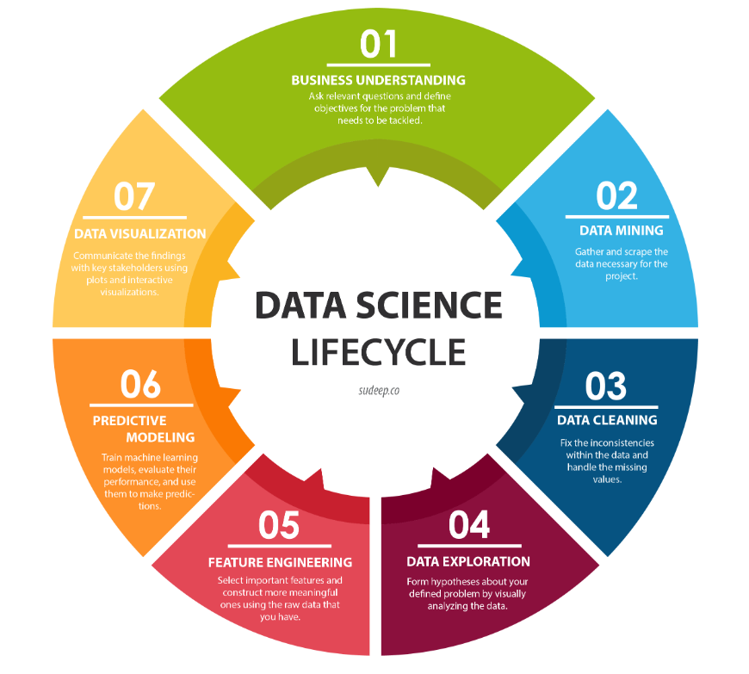
7. Data Visualization ­◉ Seventh step of the Data Science life cycle is Data Visualization

Slide 3
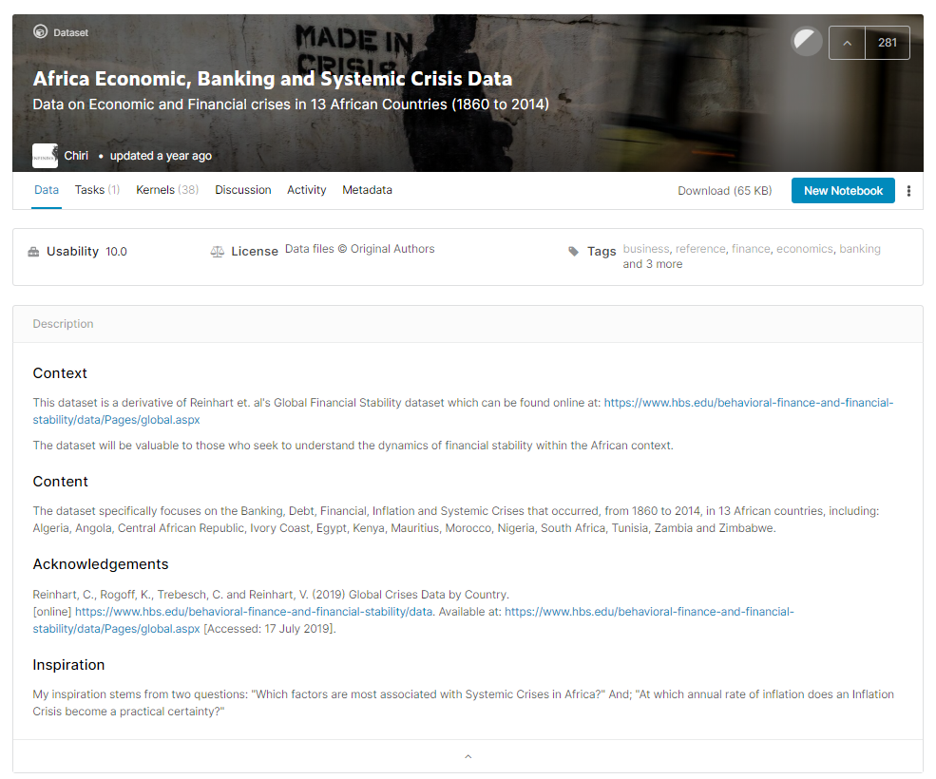
Financial Data Visualization
For financial data Visualization exercise, found this interesting dataset on Kaggle:
“Africa Economic, Banking and Systemic Crisis Data”
This dataset is valuable to understand the understand the dynamics of financial stability with the African context

Slide 4
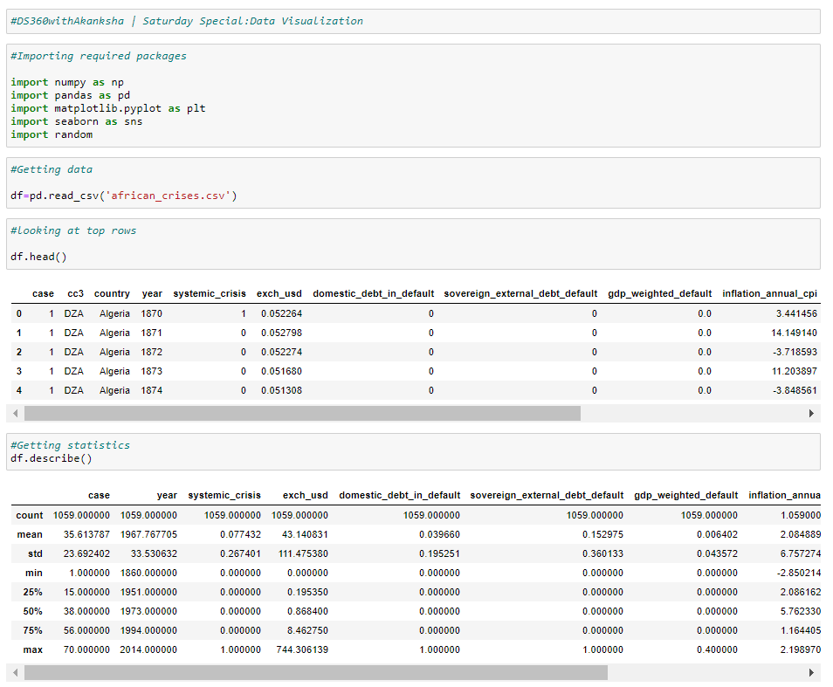
Financial Data Visualization
Started the visualization exercise by first importing the required python packages
Next imported the dataset that is available on Kaggle
Checked the sample rows & descriptive statistics of the dataset

Slide 5
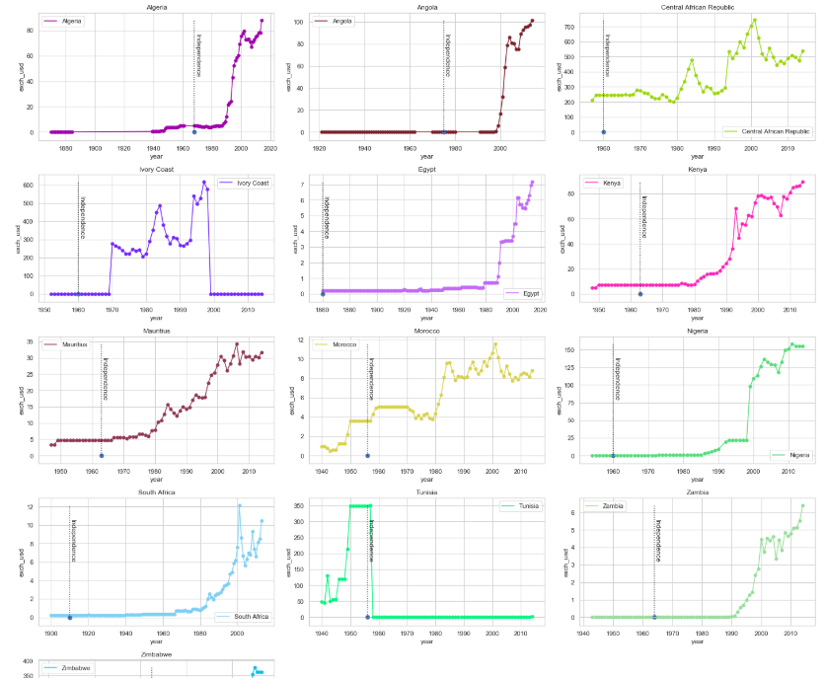
Financial Data Visualization
Visualizing year wise average USD exchange rate of each country

Slide 6
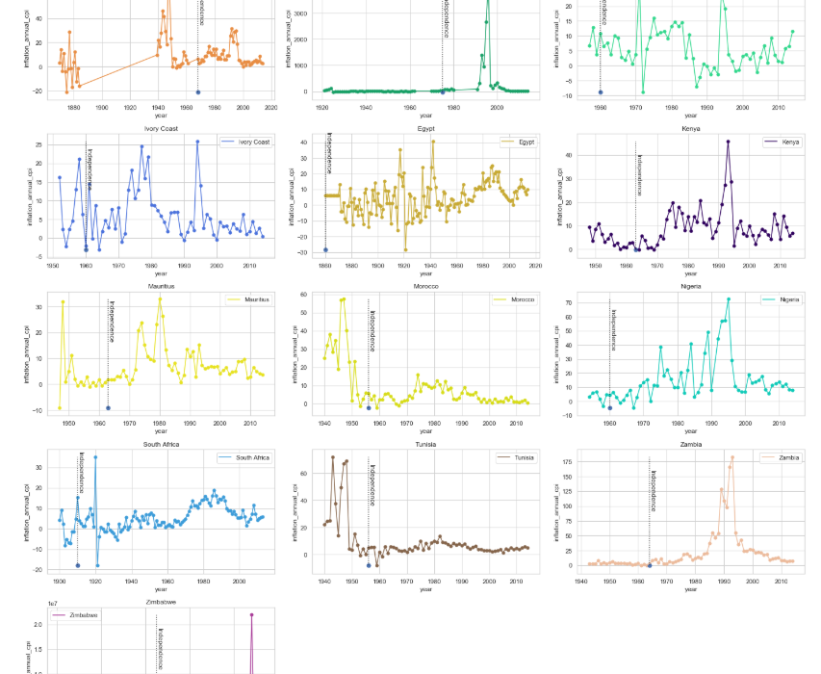
Financial Data Visualization
Visualizing year wise inflation of all the 13 African countries

Slide 7
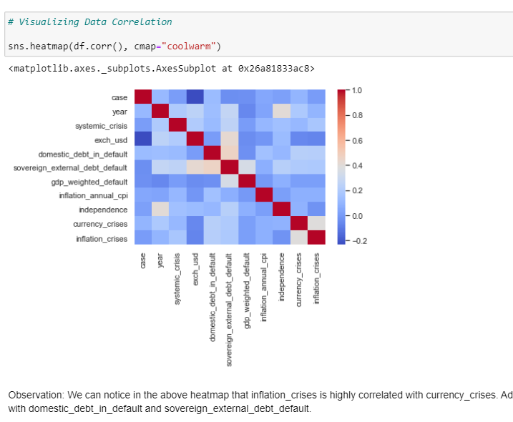
Financial Data Visualization
Analyzed the features’ correlation with the help of heatmap

Slide 8
Next Step : 1. Business Understanding

Slide 9
References
http://sudeep.co/data-science/Understanding-the-Data-Science-Lifecycle/
https://www.toptal.com/finance/financial-modeling/financial-data-visualization
https://go.oracle.com/how-data-visualization-helps-finance-tell-better-stories
https://www.oreilly.com/library/view/visualizing-financial-data/9781118907856/
https://www.tableau.com/learn/webinars/price-right-art-visualizing-finance-data
https://channels.theinnovationenterprise.com/articles/the-guide-to-visualizing-financial-data
https://www.kaggle.com/rohan8594/finance-data-project
https://www.youtube.com/watch?v=8iMlrzokZqQ
https://www.youtube.com/watch?v=8iMlrzokZqQ
https://www.youtube.com/watch?v=QPF4ccwXU78
https://www.kaggle.com/chirin/africa-economic-banking-and-systemic-crisis-data
https://www.kaggle.com/n4n4n4/create-a-correlation-heatmap-for-the-imdb-data

